Slide 1
More Recurrences
David Kauchak
cs140
Spring 2024

Slide 2
Administrative
Group sessions
Assignment 1

Slide 3
Recurrence
A function that is defined with respect to itself on smaller inputs

Slide 4
The challenge
Recurrences are often easy to define because they mimic the structure of the program.
But… they do not directly express the computational cost, i.e., n, n², …
We want to remove self-recurrence and find a more understandable form for the function

Slide 5
Three approaches
Substitution method: when you have a good guess of the solution, prove that it’s correct
Recursion-tree method: If you don’t have a good guess, the recursion tree can help. Then solve with substitution method.
Master method: Provides solutions for recurrences of the form:

Slide 6
Substitution method
Guess the form of the solution
Then prove it’s correct by induction
Halves the input then constant amount of work
Like binary search:
Guess: O(log₂ n)

Slide 7
Guess the solution?
Recurses into 2 sub-problems that are half the size and performs some operation on all the elements
O(n log n)
What if we guess wrong, e.g., O(n²)?
Assume T(k) = O(k²) for all k < n
again, this implies that T(n/2) ≤ c(n/2)²
Show that T(n) = O(n²)

Slide 8
from our inductive hypothesis
residual
if
overkill?

Slide 9
What if we guess wrong, e.g., O(n)?
Assume T(k) = O(k) for all k < n
again, this implies that T(n/2) ≤ c(n/2)
Show that T(n) = O(n)
factor of n so we can just roll it in?

Slide 10
What if we guess wrong, e.g. O(n)?
Assume T(k) = O(k) for all k < n
again, this implies that T(n/2) ≤ c(n/2)
Show that T(n) = O(n)
Must prove the exact form!
cn+n ≤ cn ??
factor of n so we can just roll it in?

Slide 11
Prove T(n) = O(n log₂ n)
Assume T(k) = O(k log₂ k) for all k < n
again, this implies that T(k) = ck log₂k
Show that T(n) = O(n log₂ n)
residual
if cn ≥ n, c > 1

Slide 12
Recursion Tree
Guessing the answer can be difficult
The recursion tree approach:
Draw out the cost of the tree at each level of recursion
Sum up the cost of the levels of the tree
Find the cost of each level with respect to the depth
Figure out the depth of the tree
Figure out (or bound) the number of leaves
Verify your answer using the substitution method

Slide 13
cost
cn²
cn²
T(n/4 )
T(n/4 )
T(n/4 )

Slide 14
cost
cn²
cn²
3/16cn²

Slide 15
cost
cn²
cn²
3/16cn²
(3/16)²cn²
What is the cost at each level?

Slide 16
What is the depth of the tree?
At each level, the size of the data is divided by 4

Slide 17
cn²
How many leaves are there?

Slide 18
How many leaves?
How many leaves are there in a complete ternary tree of depth d?

Slide 19
Total cost
let x = 3/16
?

Slide 20
Total cost
Assignment 0!

Slide 21
Recursion tree
If you went through the exact calculation (like we just did), you can be done!
Often, this isn’t feasible (or desirable).
Instead, use the recursion tree to get a good guess.

Slide 22
Verify solution using substitution
Assume T(k) = O(k²) for all k < n
Show that T(n) = O(n²)
Given that T(n/4) = O((n/4)²), then
T(n/4) ≤ c(n/4)²

Slide 23
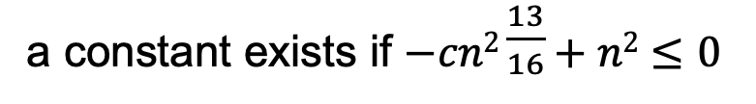
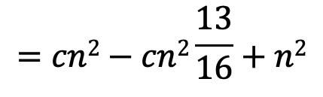
To prove that, show that T(n) = O(n²) we need to identify the appropriate constants:
i.e., some constant c such that T(n) ≤ cn²
$$=cn2−cn2\frac{13}{16}+n2$$
residual
a constant exists if $−cn2\frac{13}{16}+n2≤0$

Slide 24
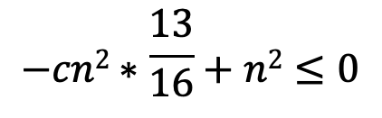
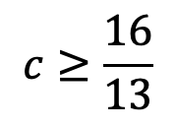
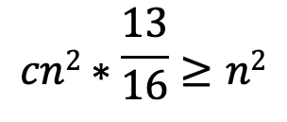
To prove that, show that T(n) = O(n²) we need to identify the appropriate constants:
i.e., some constant c such that T(n) ≤ cn²
$$−cn2∗\frac{13}{16}+n2≤0$$
$$cn2∗\frac{13}{16}≥n2$$
$$c≥\frac{16}{13}$$

Slide 25
Master Method
Provides solutions to the recurrences of the form:

Slide 26
a = b = f(n) =
16
4
n
Case 1:

Slide 27
a = b = f(n) =
1
2
2^{n}
Case 3?

Slide 28
Let c = 1/2
T(n) = Θ(2^{n})

Slide 29
a = b = f(n) =
2
2
n
Case 2:
Θ(n log n)

Slide 30
a = b = f(n) =
16
4
n!
Case 3?

Slide 31
Let c = 1/2
T(n) = Θ(n!)
therefore,

Slide 32
a = b = f(n) =
2
logn
Case 1:
Θ( )

Slide 33
a = b = f(n) =
4
2
n
Case 1:
Θ(n²)

Slide 34
Recurrences

Slide 35
Why does the master method work?
a
a
a
a

Slide 36
What is the depth of the tree?
At each level, the size of the data is divided by b

Slide 37
How many leaves?
How many leaves are there in a complete a-ary tree of depth d?

Slide 38
Total cost
Case 1: cost is dominated by the cost of the leaves

Slide 39
Total cost
Case 2: cost is evenly distributed across tree
As we saw with mergesort, log n levels to the tree and at each level f(n) work

Slide 40
Total cost
Case 3: cost is dominated by the cost of the root
a

Slide 41
Other forms of the master method

Slide 42
Changing variables
Guesses?
We can do a variable change: let m = log₂ n (or n = 2^{m})
Now, let S(m)=T(2^{m})

Slide 43
Changing variables
Guess?
substituting m=log n

